Slide 1

Descriptive Statistics & Data Exploration
BMI 6106 2023

Slide 2
Goal of today’s class
Describe the most common techniques to first evaluate and describe your data before any in depth statistical analysis

Slide 3
Overview
Introduction
Central Tendencies measurements
Mode
Mean
Median
Dispersion
Range
Standard Deviation
Variance
Confidence Intervals
Skewness
Graphical Methods (Data Exploration)
Boxplots
Outliers
Normality
qqplot
Collinearity
Homogeneity of Variance
Transformations
Missing Data – Imputation
Association – Correlation
Geographical Information System.

Slide 4
Introduction
Descriptive Statistics gives you a first glance to your data and allow you to understand better the variables from your study.
It also helps you to understand the relationship within independent variables and between independent and dependent variables

Slide 5
Central Tendencies measurements
Basic measurements of the central parameters of a variable’s distribution.
These are the first pieces of information regarding your data and help evaluate the subsequent analysis strategies.
The type of parameter to choose depends of the type of variables to evaluate

Slide 6
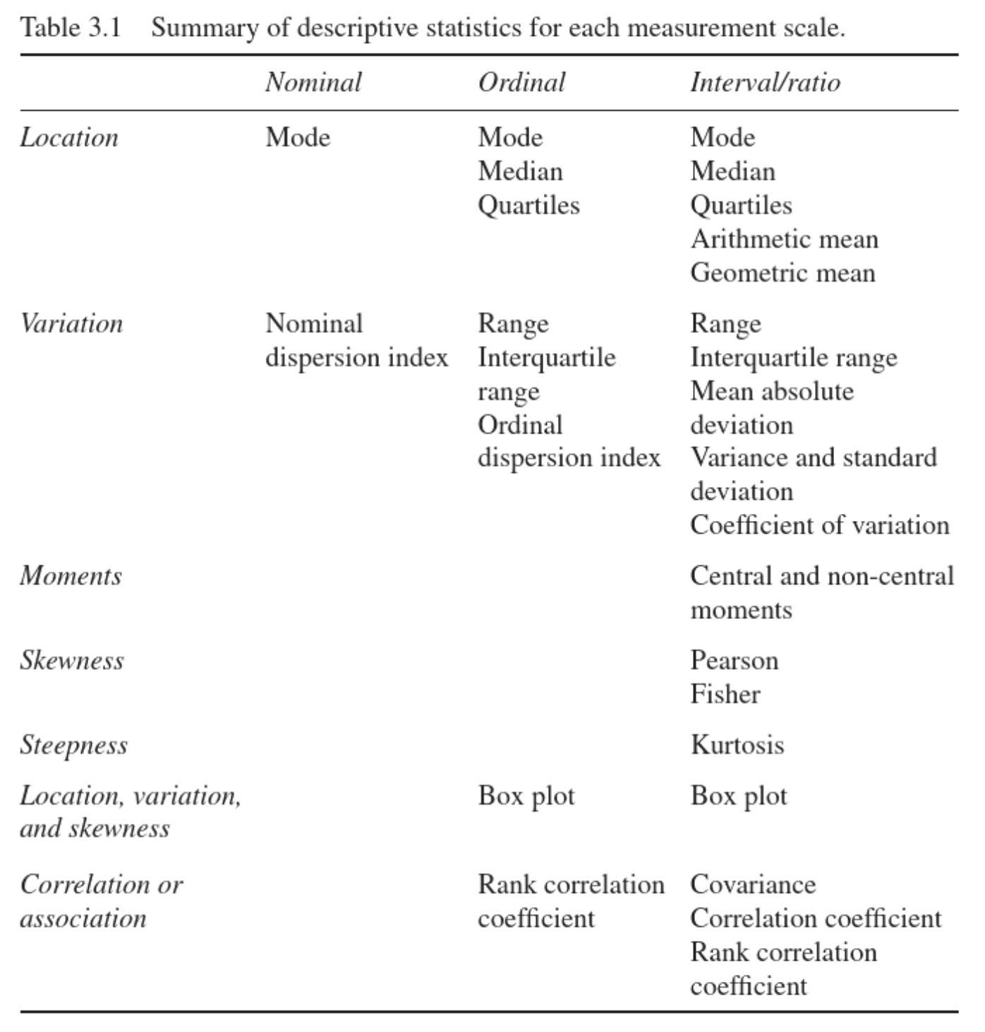
Central Tendencies measurements
Statistics with JMP: graphs, descriptive statistics and probability by Goos Peter and Meintrup David. Ebook available at the library

Slide 7
Dataset
To Demonstrate the different measurements to describe variables we are going to use a dataset related to income inequality in Brazil gathered by the Brazilian Institute of geography and statistics. The Dataset and Descriptive statistics notebook are found in Kaggle https://www.kaggle.com/upadorprofzs/statistical-analysis-descriptive-statistics-br/notebook
The Dataset contains information on several income variables as well as demographic data on over 76K individuals from different regions in Brazil.

Slide 8
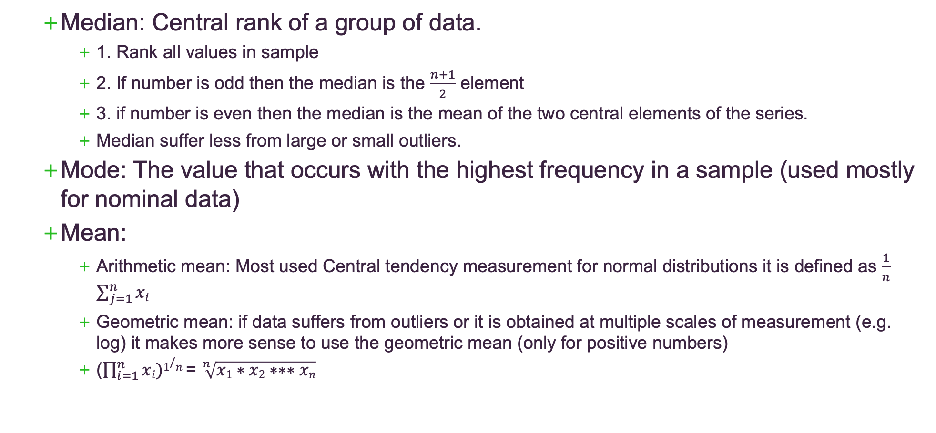
Central Tendencies measurements
Median: Central rank of a group of data.
1. Rank all values in sample
2. If number is odd then the median is the $\frac{n+1}{2}$ element
3. if number is even then the median is the mean of the two central elements of the series.
Median suffer less from large or small outliers.
Mode: The value that occurs with the highest frequency in a sample (used mostly for nominal data)
Mean:
Arithmetic mean: Most used Central tendency measurement for normal distributions it is defined as $\frac{1}{n}$ $\sum_{j=1}^{n}{xi}$
Geometric mean: if data suffers from outliers or it is obtained at multiple scales of measurement (e.g. log) it makes more sense to use the geometric mean (only for positive numbers)
($\prod_{i=1}^{n}{xi})1/n$ = $\sqrt[n]{x1∗x2∗∗∗xn}$

Slide 9
Central Tendencies measurements: relative location
Quantiles: Cut points that divides the percentiles into equal splits: most common quartile, deciles and percentiles
Percentiles: A Score below which the data falls, it allows for comparison within values in the sample.
1. Sort all your data from smallest to largest
2. calculate the position of the k-th percentile by multiplying k (percent) by n = index
3. round index to nearest whole number
4. Use the ranked dataset to locate the percentile based on the index value
Quartiles: Sample partition into quarters based on the percentiles:
Q1 lower quartile – lower 25 % sample
Q2 medium quartile – 50% sample = median
Q3 upper quartile – 75% sample
Notes:
A measure of relative location indicates the position of an observation in comparison to the values of the other observations

Slide 10
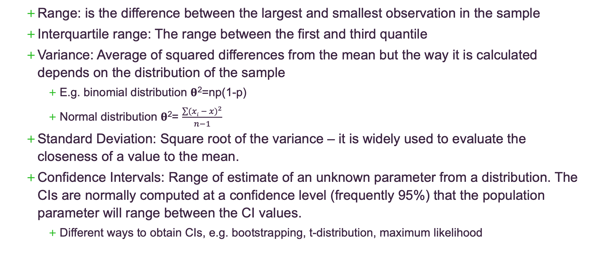
Central Tendencies measurements: Dispersion
Range: is the difference between the largest and smallest observation in the sample
Interquartile range: The range between the first and third quantile
Variance: Average of squared differences from the mean but the way it is calculated depends on the distribution of the sample
E.g. binomial distribution 𝛉²=np(1-p)
Normal distribution 𝛉²= $\frac{\sum{({xi − x)}^{2}}}{n−1}$
Standard Deviation: Square root of the variance – it is widely used to evaluate the closeness of a value to the mean.
Confidence Intervals: Range of estimate of an unknown parameter from a distribution. The CIs are normally computed at a confidence level (frequently 95%) that the population parameter will range between the CI values.
Different ways to obtain CIs, e.g. bootstrapping, t-distribution, maximum likelihood

Slide 11
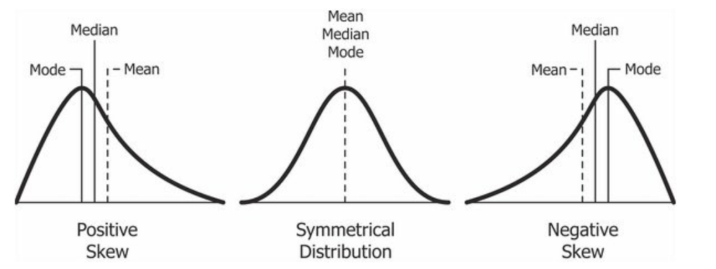
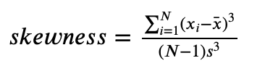
Skewness: A histogram that is not symmetric

Slide 12
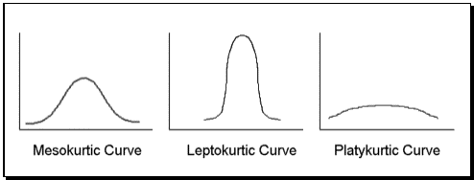

Kurtosis: Measures the effect of the outliers on the shape of the distribution.
Leptokurtic: Sharp peak.- Fat tails (positive > 3)
Platykurtic: shallow peak thin tails (negative > 3)
Mesokurtic: Normal distribution

Slide 13
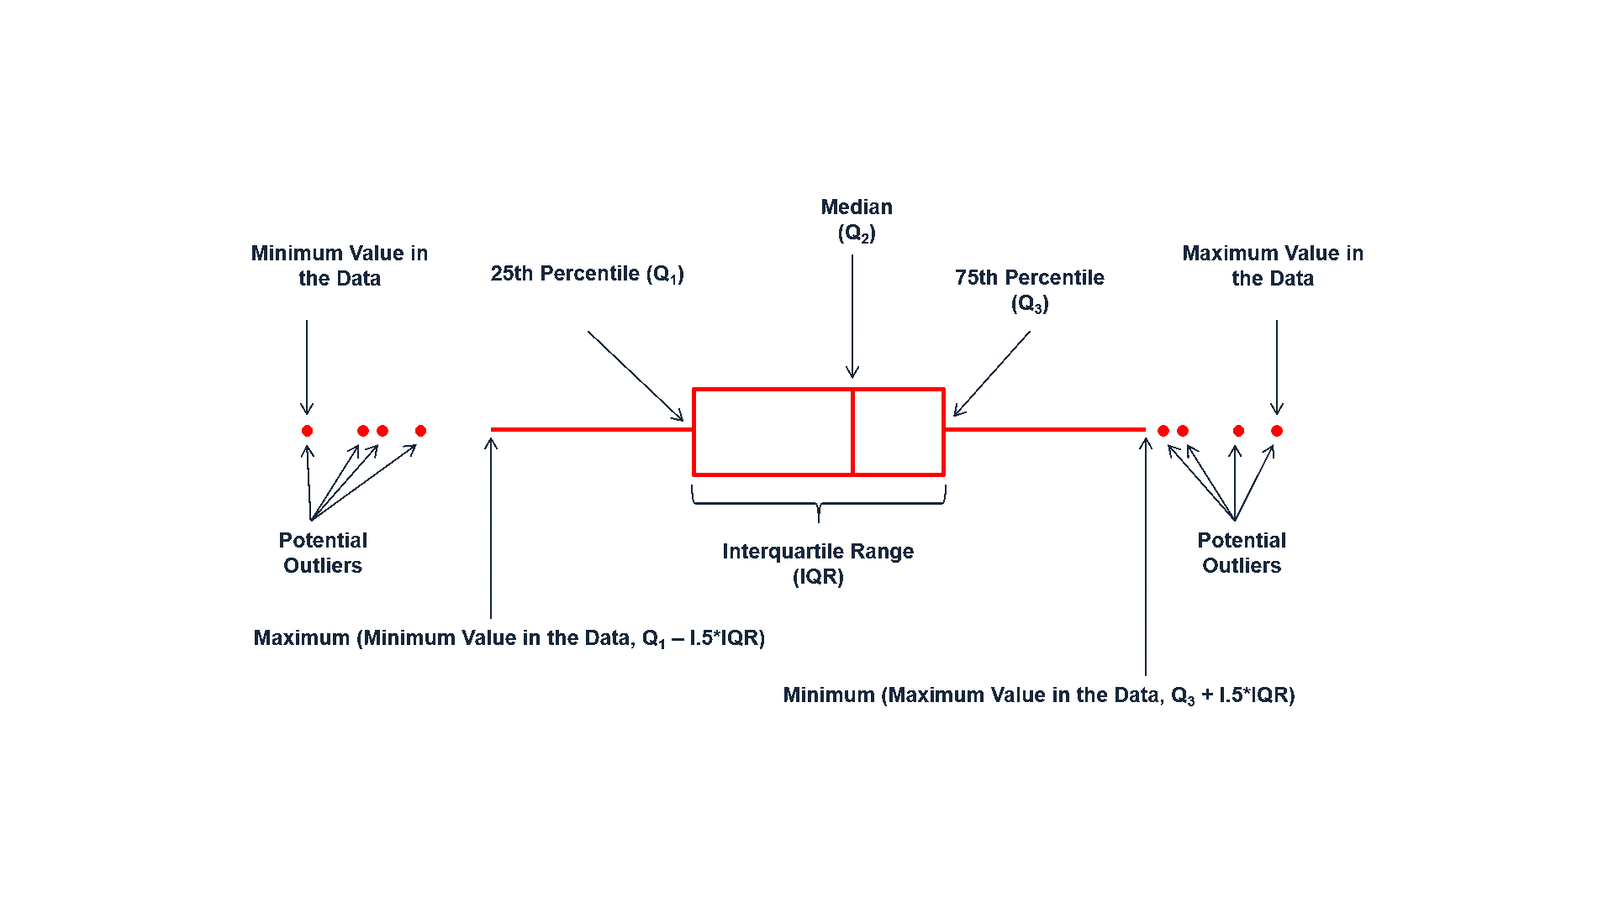
Boxplots
Graphical Representation of the central tendency measurements
https://www.kaggle.com/upadorprofzs/statistical-analysis-descriptive-statistics-br
Notes:
The box plot gives an idea of the position, dispersion, asymmetry, tails and outliers. The central position is given by the median and the dispersion by 𝐼𝐼𝑄IIQ. The relative positions of 𝑄1Q1, 𝑀𝑒𝑑𝑖𝑎𝑛Median and 𝑄3Q3 give a sense of the symmetry of the distribution. Tail lengths are given by the lines that go from the rectangle to the remote values and by the outliers.

Slide 14
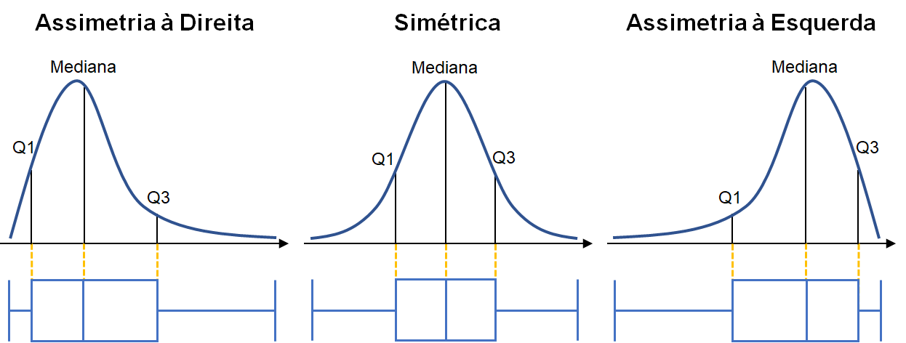
Boxplots
Graphical Representation of the central tendency measurements
https://www.kaggle.com/upadorprofzs/statistical-analysis-descriptive-statistics-br
Notes:
The box plot gives an idea of the position, dispersion, asymmetry, tails and outliers. The central position is given by the median and the dispersion by 𝐼𝐼𝑄IIQ. The relative positions of 𝑄1Q1, 𝑀𝑒𝑑𝑖𝑎𝑛Median and 𝑄3Q3 give a sense of the symmetry of the distribution. Tail lengths are given by the lines that go from the rectangle to the remote values and by the outliers.

Slide 15
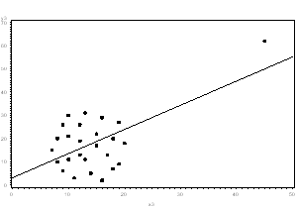
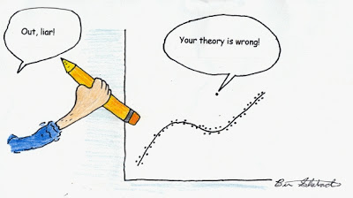
Outliers !!!Do Not Remove Outliers Before Investigating What do they Represent!!!
The outlier has a value that is far from the bulk of the data (can go on either direction).
These outliers are highly damaging as they can drive a particular analysis one way or the other
In Multivariate analysis such as PCA (which we will cover soon) outliers tend to dominate the first main components, thus in some circumstances driving opposite conclusions.
However, outliers can have a substantial analytical model, it can point to interesting behaviors of the data, be of biological relevance or illustrate relevant flaws with a particular design.

Slide 16
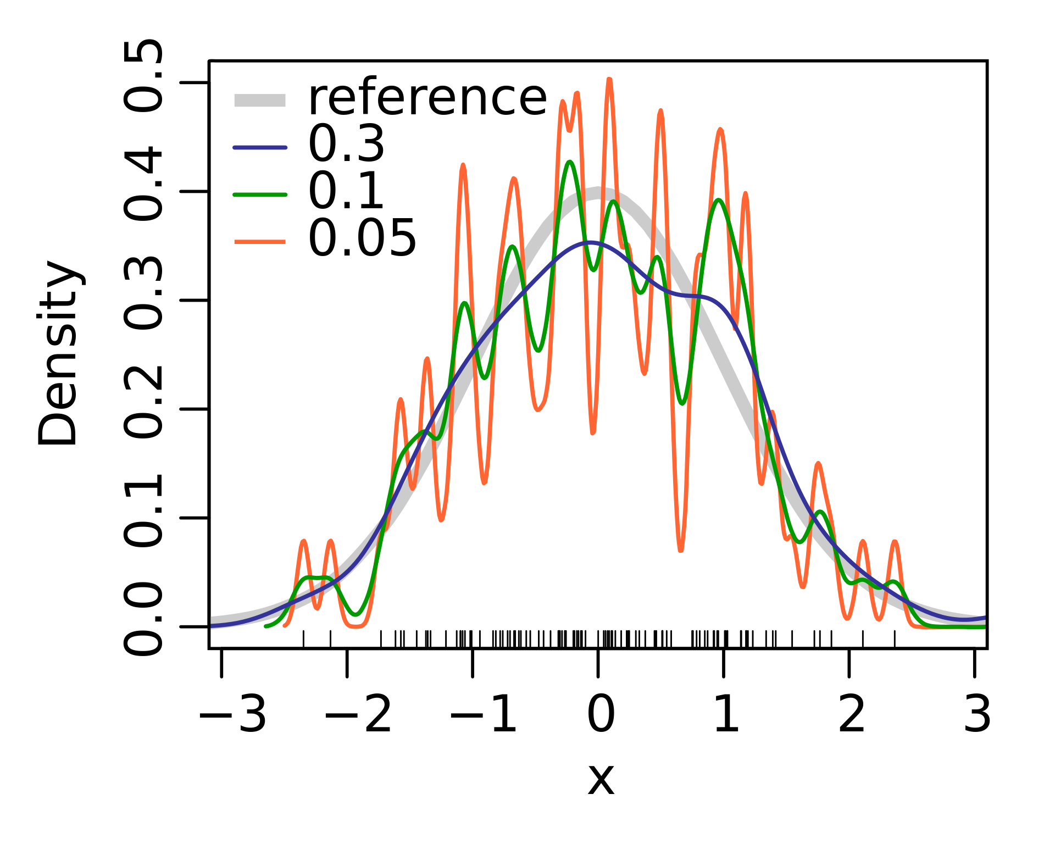
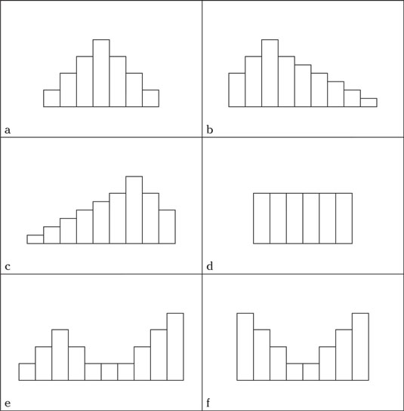
Histograms
Representation of distribution of the data:
Histogram:
Create bins of range of values
Count how many values fall on each bin
X axis range of values sample
Y axis Frequency for each bin
Kernel density curves:
Non-parametric calculation of the PDF of a random variable
It requires a smoothing parameter to adjust the kernel

Slide 17
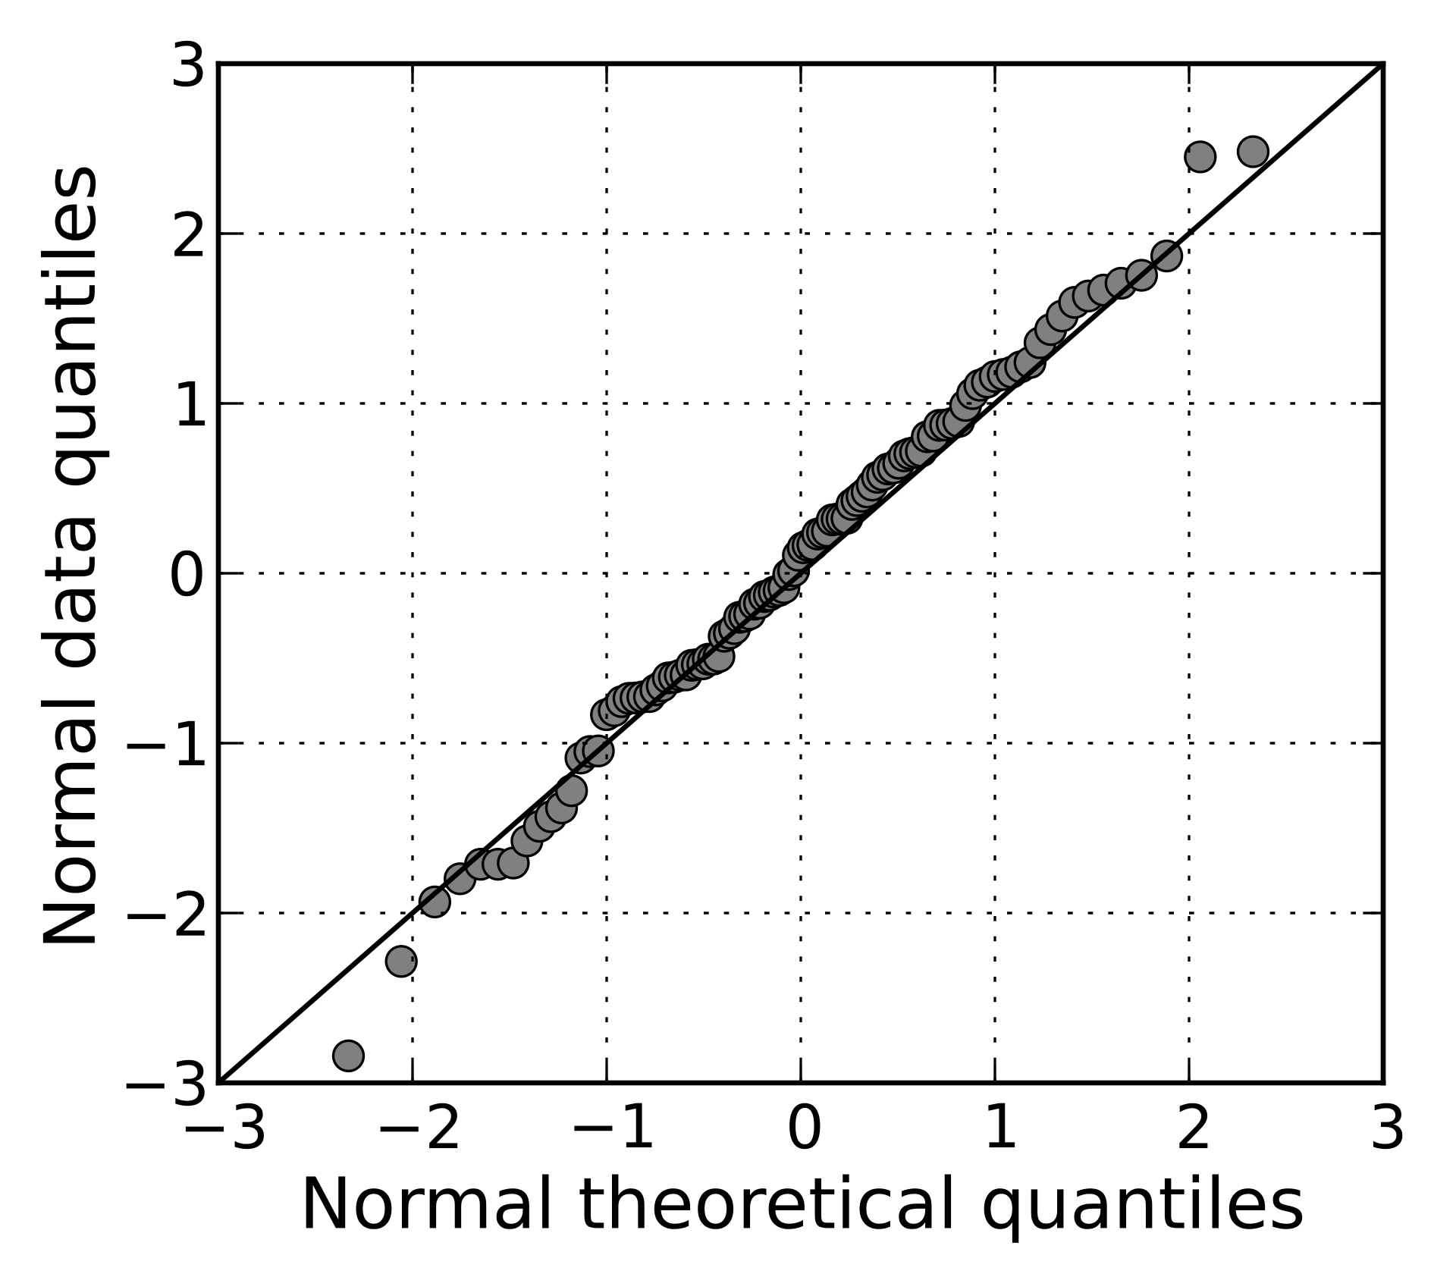
Normality
Many tests require that the samples be normally distributed, there are graphical and statistical ways to assess normality of a sample:
q-q plots: quantile-quantile plots: plot the quantiles distributions of two variables against each other
qqnorm: compares normally distributed quantiles against sample quantiles
Notes:
The basic idea is to plot the quantiles distributions of two variables against each other. We then draw a straight line and if the plots approximately fall within the boundaries of the line then we can infer that the distributions are similar.
We can plot the quantiles from the raw data against any distribution quantiles and check for similitudes of the distributions.

Slide 18
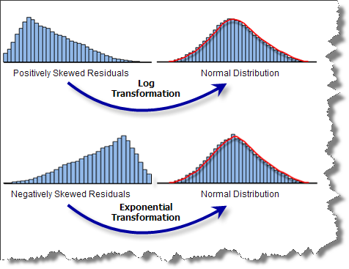
Transformations
Transformations are used to reduce skewness of a distribution to a more normally distributed shape.
Common Transformations are:
Log10
Exponential
Reciprocal
Cube root
Square root
See short paper on canvas

Slide 19
Future lectures
Missing Data – Imputation
Collinearity
Homogeneity of Variance

